Slide 1
Electric Vehicles 101

Slide 2
Different Kinds of EVs
There are 3 types of EVs
Battery Electric Vehicle (EV or BEV)
100% electric
Refuel from charging stations only
0 emissions
Plug-in hybrid electric vehicle (PHEV)
Electric motor and a combustion engine
Refuel at gas stations and charging stations
Can go a moderate range (<50 miles) pure electric before switching to combustion engine
Hybrid Electric Vehicle (HEV)
Primarily uses a combustion engine
Refuel only at gas stations
Uses an electric motor only at very low speeds and to increase MPG

Slide 3
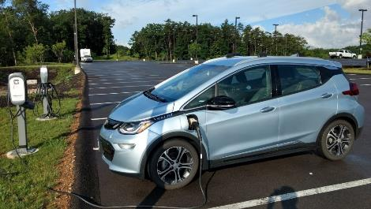
Battery Electric Vehicle
Chevy Bolt
Chevy Bolt
Range: 238 miles, all electric, zero emission driving
Cost: $37,495 (before any tax credits)
Efficiency: ~119 MPGe (EPA calculated)
0-60 in 6.5 seconds, top speed of 98 mph, 5 star crash rating

Slide 4
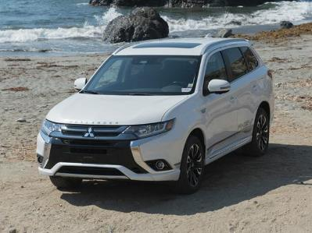
Plug-in Hybrid Electric Vehicle
Mitsubishi Outlander
Range: 22 miles of all-electric range before using the combustion engine
Costs: $34,595 (before any tax credits)
Efficiency: ~74 MPG while electric, 25 when using engine
1500 pounds of towing capacity

Slide 5
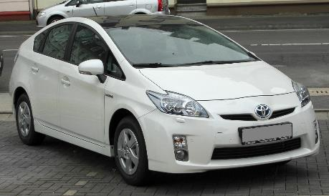
Hybrid Electric Vehicle
Toyota Prius
Cost: $23,475; no tax credits for HEVs
Efficiency: Combined 52 MPG
No fully electric miles

Slide 6
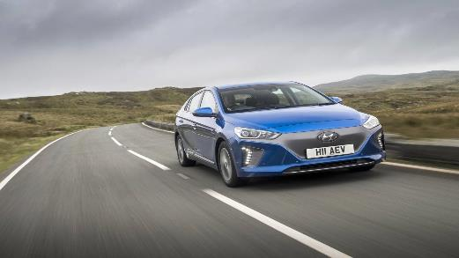
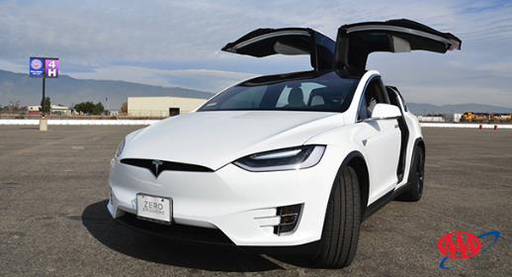
Benefits of EV ownership
Greenhouse gas reductions
Cleaner communities
Lower cost to operate and maintain
Electric vehicles can perform almost all the functions of traditional vehicles
Fun to drive

Slide 7
Environmental Motivation
Small vehicle exhaust makes up most of the transportation portion
Energy generation becomes cleaner in the US every day!
Notes:
According to the EPA, 61% of transportation emissions come from small engine vehicles. In Minnesota, transportation makes up an even bigger section of the pie. As electricity becomes more renewable, EVs help reduce GHG emissions even more by being fueled by cleaner energy and reducing an even more significant section of emissions.

Slide 8
Community Impact
Clean air benefits the whole community
Negative health consequences of vehicle exhaust are real
No engine noise pollution
Notes:
https://www.sciencedirect.com/science/article/pii/S0140673602112748
Vehicle exhaust has been linked to a variety of health conditions, like pulmonary disease and asthma.
Reduced emissions benefit everyone in a community by making the air more clean.
https://www.tandfonline.com/doi/abs/10.1080/00039896.1993.9938393

Slide 9
Costs to Operate an EV
EVs are cheaper to own and operate overall
Fueling an EV costs less than half of the price to fuel a traditional car
EVs require significantly less maintenance
Notes:
http://www.driveelectricmn.org/mit-study-electric-vehicles-are-cheaper-and-emit-less-ghgs/
Calculate your eGallon: https://www.energy.gov/maps/egallon

Slide 10
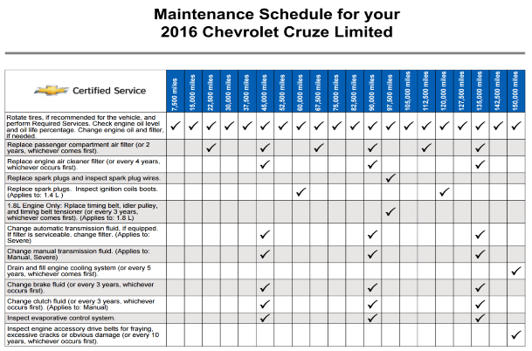
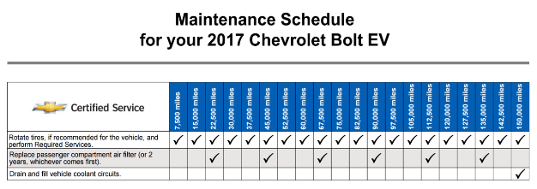
O&M Costs – Chevy Comparison
2016 Chevrolet Cruze Limited
2017 Chevrolet Bolt EV

Slide 11
Thank You!
Diana McKeown
MetroCERT Director
dmckeown@gpisd.net
612-278-7158
Kris Acuña
Project Assistant
kacuna@gpisd.net
612-400-6291
Notes:
Instructions: This slide deck is meant to provide you with the necessary resources and talking points you need to educate fleet managers and others about electric vehicles in your community. To use these slides in your own presentation, simply copy and paste the slides you would like to use.
Attribution: This content has been authored and compiled by the Great Plains Institute—credit in any presentation of these slides is not necessary but would be greatly appreciated.

